Slide 1
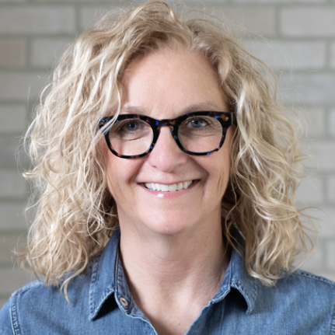
Kathleen Sances
President and CEO, G-PAC
gpacillinois.com

Slide 2
Moving forward
Stakeholder & coalition policy agenda
gpacillinois.com

Slide 3
Prohibit Assault Weapons and Dangerous Hardware
1 | Large capacity magazine (LCM) ban*
2 | Assault weapons ban

Slide 4
Updates to the FOID Process
1 | Raise the age to obtain a FOID card to 21*
2 | If the age for FOID cards is not raised to 21, prohibit FOID co-signer if individual has a history of violence or other violent indicators
3 | Fingerprint requirement*
4 | Apply in person*
5 | Require safety training*
6 | Move up implementation of universal background check to Jan. 2023 (Jan. 2024)
7 | Codify into law the clear and present danger emergency rule*

Slide 5
Strengthening Firearm Restraining Order (FRO)
1 | Assign statewide FRO coordinators to serve as a liaison between petitioners and the court system.*
2 | Mandate clear and comprehensive reporting on FRO use.*
3 | Mandate FRO training for those involved in implementation.*
4 | Expand the list of eligible FRO petitioners to include licensed healthcare providers.*
5 | Provide FRO education to key partners and advocates in the violence prevention space.*
6 | Extend the six-month FRO to one year.*
7 | Utilize Byrne JAG funding for FRO implementation.*

Slide 6
Prevention, Trauma and Justice
1 | Funding community violence intervention programs and community healing centers
2 | Provide justice to victims and families by improving clearance rates and other steps to improve justice

Slide 7
Gun Trafficking and Industry Accountability
1 | Victims' access to justice and industry accountability bill*
2 | Address trafficking from neighboring states by establishing an anti-gun-trafficking unit within ISP*
3 | Create database on the make, model, caliber and ammunition capacity for every gun injury and homicide
4 | Digitize 4473 forms in searchable database for ISP
5 | Establish Illinois as a gun violence research center funded by the state

Slide 8
Statewide Priorities
1 | Large capacity magazine (LCM) ban*
2 | Assault weapons ban
3 | Funding community violence intervention programs and community healing centers
4 | Provide justice to victims and families by improving clearance rates and other steps to improve justice

